Slide 1


2025-26 Title l Annual Parent Meeting
Azalea Elementary
August 27th, 2025
5:30 p.m.-7:30 p.m.
Donita O. Moody, Principal
Brenda Butler, Assistant Principal
Notes:
Welcome to our Title I Annual Meeting. My name is Donita Moody. I am the proud principal of Azalea. This presentation will provide important information about our Title I program.

Slide 2




All About Title l
Title I is the largest federal assistance program for our nation’s schools.
The program serves 99 schools in Pinellas County including eligible students in 39 non-public schools.
The Title l goal is that every student achieves high levels of academic proficiency.
Notes:
The Title I program in Pinellas county serves 99 schools which includes 39 non-public schools. The goal is that every student achieves high levels of academic proficiency.

Slide 3

Title I Funding Process
2. Florida Department of Education
1. Federal Government
Azalea Elementary
3. Pinellas County Schools
Notes:
The Florida Department of Education receives funds from the federal government. Districts receive Title I funds from Department of Education, and district distributes these funds to schools based on the percentage of children eligible for free/reduced price lunch.

Slide 4


Title l Supplemental Resources
Definition: provided in addition to what is already present or available to compete or enhance resources
Notes:
Definition: Title I Supplemental resources provide additional academic support and learning opportunities for economically disadvantaged students.

Slide 5
Azalea Elementary maintained our
2024-2025
letter grade of an
A.
Way to Go Azalea!
Let’s Celebrate!
Notes:
Based on the FAST data and school grades, there is a lot to celebrate!! We earned an A. Title I funds provided additional instructional supports and resources to help us reach our goal.

Slide 6
Supplemental Resource | Positive Impact
Additional supplemental personnel | We have an on-site full time MTSS coach. Two Title I Hourly Teachers
Additional training opportunities for school staff | Equips teachers with new strategies in reading, math, differentiated instruction, and technology integration
Extended Learning Opportunities (before and/or after school programs) | Provides students additional time to practice skills
Supplemental teaching materials, equipment, and technology | Allows teachers to deliver lessons that are more engaging, interactive, and differentiated. This helps meet the varied learning needs of students.
Parent and Family Engagement Resources and Training Workshops | Workshops and resources give families the tools to support learning at home
Title I Programs Provide Supplemental Support
Notes:
Title I funds are uses to provide hourly teachers, an MTSS coach, and instructional materials.

Slide 7
Title I Schoolwide Planning and Input
First
Second
Last
Seek Input from school, family, and community members determine how Title I funds are used based on a needs assessment.
Please attend online or in-person meetings/trainings and complete surveys to provide input on Title I funding.
All Title I schools must document that parents are involved in the schoolwide planning process.
Notes:
Your input is important to us and helps us with schoolwide planning. Please use the input form in your child’s classroom to provide input regarding title I.

Slide 8

Title I Schoolwide Budget
Azalea Elementary is provided approximately $60,000 to pay for supplemental resources and programs for increased student achievement.
Azalea Elementary currently uses that funding to purchase supplies, and provide hourly teachers, and a MTSS Coach.
Notes:
Azalea Elementary is provided approximately $60,000 to pay for supplemental resources and programs for increased student achievement.

Slide 9
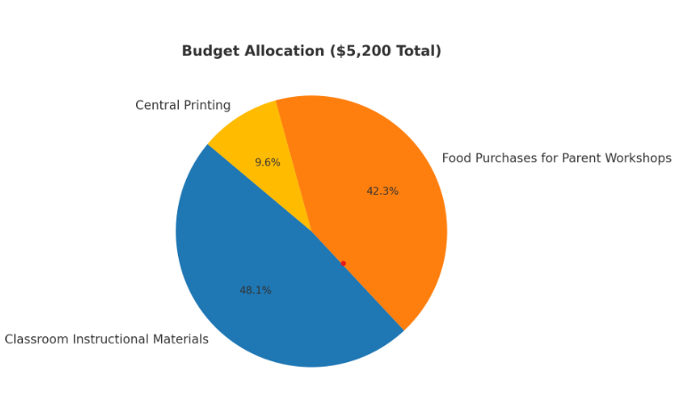
Azalea Elementary’s Title I Parent & Family Engagement
2025-2026
Budget
Total Allocation - $5,200
Classroom Instructional Materials $2,500.00
Food Purchases for
Parent Workshops - $2,200.00
Central Printing $500
Notes:
Our Total Allocation for Parent and Family Engagement- $5,200
Which will include Classroom Instructional Materials $2,500.00
Food Purchases for
Parent Workshops - $2,200.00
Central Printing $500

Slide 10

Parent’s Right to Know
As a parent of a student attending a Pinellas County School Public School, you have the right to…
Be
Be provided information on your child’s level of achievement on assessments in Reading/Language Arts, Writing, Mathematics, and Science.
Request and receive information on the qualifications of your child’s teacher and supplemental personnel working with your child.
Be
Be notified of non-highly qualified or out-of-field teachers at the school.
Be
Be informed if your child is taught by a non-highly qualified teacher for four or more consecutive weeks.
Notes:
As a parent of a student attending a Pinellas County Public School, you have the right to… -Be provided information on your child’s level of achievement on assessments and to
-Request and receive information on the qualifications of your child’s teacher and supplemental personnel working with your child.

Slide 11
Working Together for Student Success
School
School Improvement Plan (SIP)
Title
Title I Schoolwide Plan
Parent
Parent and Family Engagement Plan
School
School-Parent-Student Compact
Title l is now included as a part of the School Improvement Plan
Notes:
As a Title I parent you have the right to be involved in the development of the following plans for our school which can be found on our website.
School Improvement Plan, Title I Schoolwide Plan, School’s, Parent and Family Engagement Plan, and the Compact,

Slide 12

Parent-School-Student Compact
The purpose of the compact is to foster student achievement. By signing the Parent-School-Student Compact, Azalea Elementary, teachers, staff, parents and students agree to work together to share the responsibility of helping students meet or exceed state, district and school academic goals.
The Parent-School-Student Compact is updated every year to include parent, student, teacher, and staff input. Parent, student, teacher and staff comments are welcome at any time during the year.
Please review and sign your child’s Compact.
Our goal is to receive 100% signed compacts!
Notes:
The purpose of the compact is to foster student achievement At the elementary level, school compacts are used as a progress monitoring tool through the year during parent teacher conferences.

Slide 13
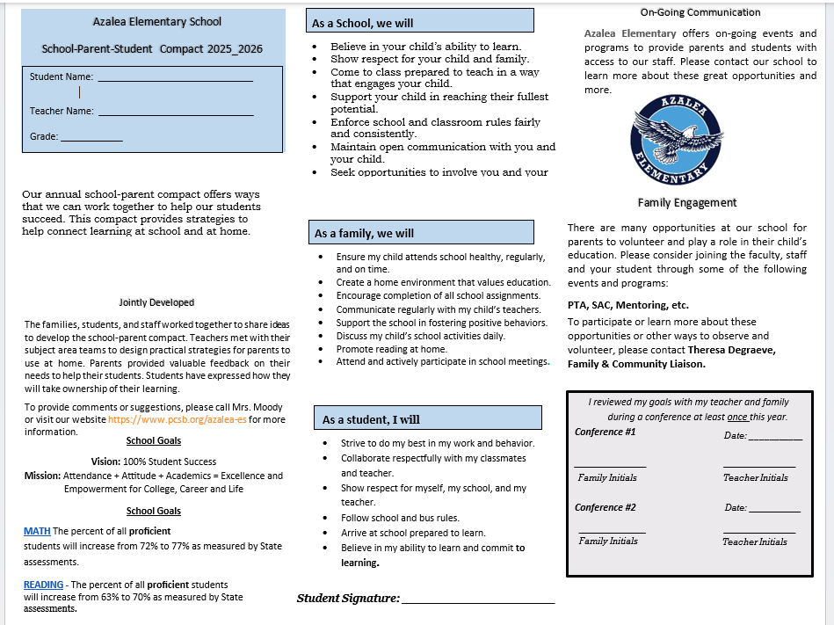
Sample School Compact
Notes:
Here is an example of what our compact looks like. offers ways that we can work together to help our students succeed.

Slide 14

Parent and Family Engagement Plan (PFEP)
The PFEP Sections include information about the following:
  Parent trainings to increase student achievement
  Staff trainings for engaging parents
  Communication methods between home and school
  Flexible meeting times
  Accessibility for parents
  Coordinating with other Federal Programs
  To access the full LEA PFEP, please visit
  www.pcsb.org/titleone
Notes:
We encourage you to increase engagement by joining our monthly School Advisory Committee and SAC Meetings and Parent Teacher Association Meetings
PTA Meetings in addition to other school events

Slide 15
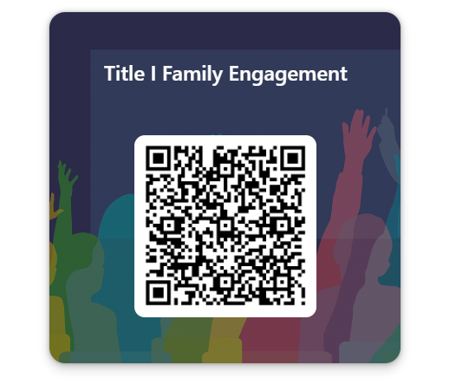
Opportunity for Two Way Communication
Take out your phone!
As listed in the previous slide, the PFEP ensures that families are provided with flexible meeting times.
Take out your phone!
Please use this QR code to provide your input.
Notes:
Take out your phone and use this QR code.
As listed in the previous slide, the PFEP ensures that families are provided with flexible meeting times.
Take out your phone!
Please use this QR code to provide your input.

Slide 16


Florida Benchmark For Excellent Student Thinking Standards (B.E.S.T). You may read more information by visiting, www.fldoe.org.
Notes:
All curriculum, instruction and assessments are based on student-centered expectations.

Slide 17

  School Report Cards
  School Grade and Overview
  Population and Enrollment
  Assessments – Academic Achievement, Growth, and Population
  Assessments – English Language Learners
  Graduation and Beyond
  Educator Qualifications and Equity
  Long-Term Goals and Interim Progress
  Accelerated Course Enrollment
  Per-Pupil Expenditures
  National Data
  Available online at https://edudata.fldoe.org/
Notes:
Please visit Edudata.fldoe.org to access additional information regarding the FL DOE accountability system

Slide 18
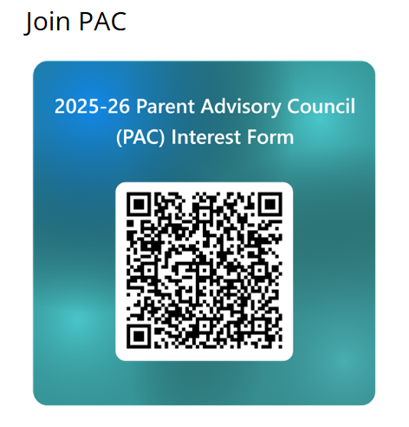

Parent Advisory Council (PAC)
The District has a Parent and Family Engagement Plan. The summary of the plan is in the Title I School & Family Partnership Overview.
You may access the full plan at www.pcsb.org/titleone
The Parent Advisory Council (PAC) is responsible for reviewing and revising the District PFEP.
PAC will meet virtually or in person with the district’s Title I staff.
Each school is committed to having at least one member representative in PAC.
PAC meets twice a year, if you are interested in representing our school please notify, Principal Donita O. Moody.
Notes:
The District has a Parent and Family Engagement Plan. The Parent Advisory Council (PAC) is responsible for reviewing and revising the District PFEP. PAC meets twice a year, if you are interested in representing our school please notify, Principal Donita O. Moody.
https://forms.office.com/r/r5daaMTENE\

Slide 19
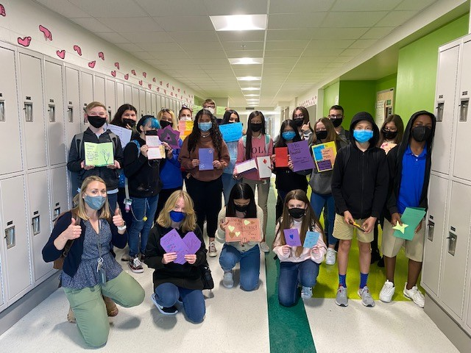

Additional Resources
Learning at Home Family Resources - https://www.pcsb.org/Page/32836
Volunteer in a Pinellas County School - https://www.pcsb.org/Page/459
Parent Academy POWER HOURS Webinars - https://www.pcsb.org/Page/26534
Partnerships - https://www.pcsb.org/Page/418
Notes:
Here are additional FAMILY resources. This presentation will be added to our website so you have access to it beyond today.

Slide 20

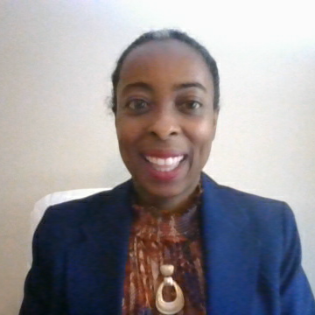
Thank you for your time!
Notes:
Thank you again for attending our Title I annual meeting.

